Slide 1
Atomic Structure PFA

Slide 2
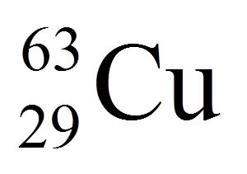
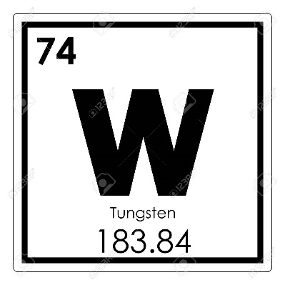
To today PFA today you need:
Pass diagnostic with 80% or better
Answer the following questions correctly:
How do you find the mass of an atom when given
protons, neutrons, and electrons?
Which number is the mass? (Top or bottom)
Subatomic Particle | Charge | Location | Mass
Proton
neutron
elelctron
Protons, Neutrons, Electrons and Mass (rounded) for element below.

