Slide 1
Balancing Equations/Word Equations

Slide 2
Agenda Day 1
Notes over word equations and balancing equations
Types of Reactions POGIL
HW: Balancing Equations and Word Equations WS

Slide 3
By the end of today you should be able to:
Translate a chemical equation from words to formula and formula to words.
Balance a chemical equation.
Begin to recognize the 5 types of chemical reactions.

Slide 4
Ch. 8 Notes -- Chemical Reactions
Chemical equations give information in two major areas:
1. _____________ and ______________ of the reaction.
2. Coefficients of a balanced chemical equation tell us the ______ of the substances involved.
Example of a Balanced Chemical Equation: 2H_{2 (g)} + O_{2 (g)} → 2H₂O _{(g)}
Review: Reactants are on the ______ side of the arrow, and the
products are on the __________ side. The arrow means “________”,
or “reacts to produce” when read aloud.
From our example, hydrogen reacts with oxygen in a ___:___ ratio.
The coefficients represent either the number of _________ or molecules present.
The coefficients can also represent _________ if the substances are gasses.
(1 mole = 6.02 x 10²³ molecules, 1 mole of gas= 22.4 Liters)
Reactants
products
amount
left
right
yields
2 1
moles
liters

Slide 5
Common Symbols used in Chemical Equations
(See Table 8.1)
+ = used to separate 2 reactants or 2 products from each other
→ = “yields” or “reacts to produce”
= _____________ reaction (like a rechargeable battery)
(s) (l) (g) (aq) = phase of matter: (solid, liquid, gas, or “aqueous”)
= ___________ supplied to the reaction
MnO₂ = a catalyst, (in this case, MnO₂), is used to ________ ____ the reaction.
= _______ given off as a product
= ______ precipitate produced
reversible
heat
speed up
gas
solid

Slide 6
Decoding Common Chemical Equation Symbols
Practice Problems: Describe the following reactions using complete sentences.
a) NaHCO₃ _{(s)} + HCl _{(aq)} → NaCl _{(aq)} + H₂O _{(l)} + CO₂
b) H₂SO₄ _{(aq)} + BaCl₂ _{(aq)} → HCl _{(aq)} + BaSO₄ _{(s)}
c) Write a chemical equation from the following description: “Sodium plus bromine, when heated, reacts to produce solid sodium bromide.”
Solid
sodium bicarbonate
plus
aqueous
hydrochloric acid
yields
aqueous
sodium chloride
plus
water
plus
carbon dioxide gas.
Aqueous
sulfuric acid
plus
aqueous
barium chloride
yields
aqueous
hydrochloric acid
plus
solid
barium sulfate.
Na _{(s)}
+
Br₂
→
NaBr _{(s)}
_{(l)}

Slide 7
Balancing Chemical Equations:
In your notes write down the rules for balancing a chemical equation from the next 2 slides.

Slide 8
Steps to Balancing and Equation Part 1 (Balancing the Compounds)
Symbols for Reactants
Symbols for Products:
A: Combination: 2 elements or molecules combine (stick them side by side) to make products
B: Decomposition: 1 molecule makes 2 parts (take it apart _____+ _____)
C. Single Replacement: single + ionic and single guys replaces the same in the ionic.
D. Double Replacement: 2 ionics trade partners 1,2 and 3,4 make 1,4 and 3,2.
Check charges in compounds
Drop cross (make sure you check your criss-cross for correct chemical formulas)

Slide 9
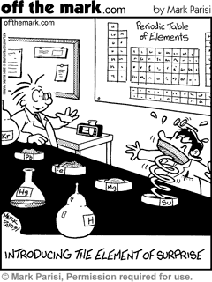
Steps to Balancing an Equation Part 2(the actual equation)
Double Cross (biggest coefficient trades)
Match another element
Match another element
Check to make sure that the equation is balanced.
Reduce coefficients to lowest terms.

Slide 10
Let’s Practice

Slide 11
Balancing Chemical Equation Practice
Practice Problems: Balance the following reactions using complete sentences.
a) NaHCO₃ _{(s)} + HCl _{(aq)} → NaCl _{(aq)} + H₂O _{(l)} + CO₂
NaHCO₃ _{(s)} + HCl _{(aq)} → NaCl _{(aq)} + H₂O _{(l)} + CO₂ (balanced ☺)
H₂SO₄ _{(aq)} + BaCl₂ _{(aq)} → HCl _{(aq)} + BaSO₄ _{(s)}
H₂SO₄ _{(aq)} + BaCl₂ _{(aq)} → 2HCl _{(aq)} + BaSO₄ _{(s)}
c) Write a chemical equation from the following description and balance the equation: “Calcium plus solid iodine, when heated, reacts to produce solid calcium iodide.”
Ca
+
I₂
→
CaI₂ _{(s)}
_{(s)}
_{(s)}

Slide 12
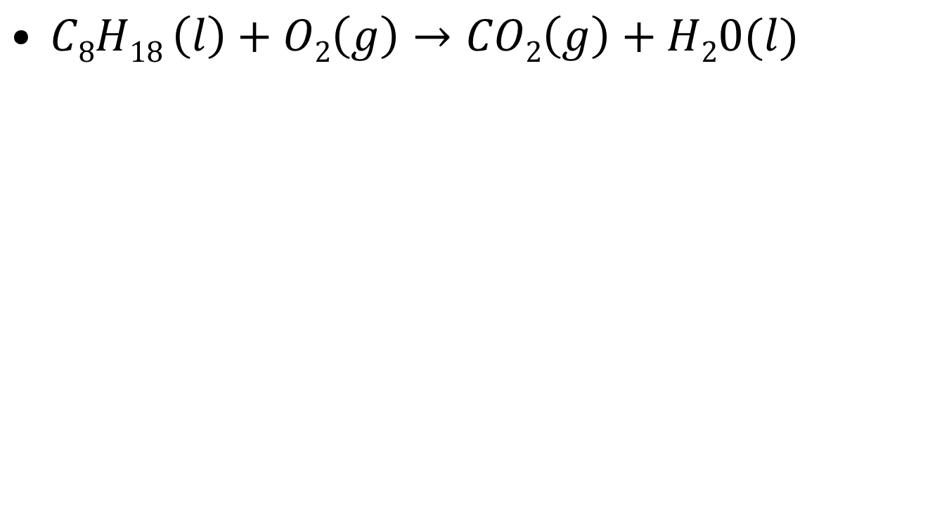
Here is a really big one to balance ☺
$C8H18 \left(l\right)+O2\left(g\right)→CO2\left(g\right)+H20(l)$

Slide 13
Time to Think
When balancing chemical equations it is important that we have the same number of each element on both sides of the yield sign. Why is this?

Slide 14
POGIL
You have been put into groups of 3 for the POGIL.
Elect a manager, recorder, and spokesman and write the names and roles on 1 POGIL (so you only write on 1 POGIL).
When you are done, please answer these questions and be prepared to have your spokesperson answer (see next slide).

Slide 15
POGIL Questions
What kinds of things do chemists use to classify chemical reactions into types?
What are some of the other important symbols that chemists use to identify important features of a chemical reactions (ex: states of matter)?

Slide 16
HW
Molecular Geometry Labs (if you still need to finish them)
Word Equations WS (Try all odds)

