Slide 1
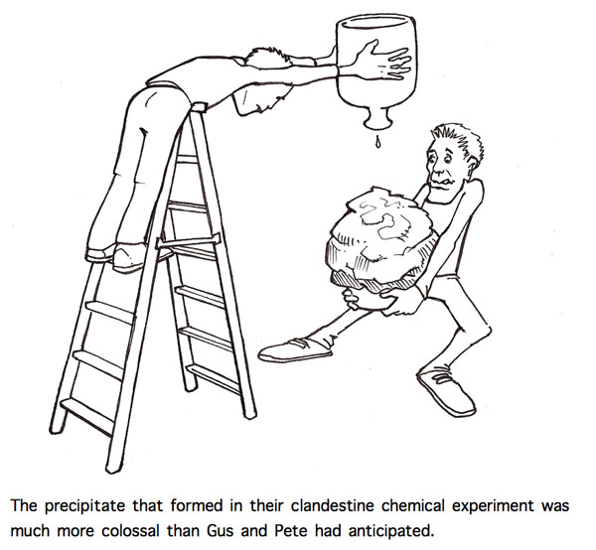
Agenda Day 3
Warm-up: SR reactions
Collect SR WS
Notes over double-replacement reactions
Demos
Double Replacement WS

Slide 2
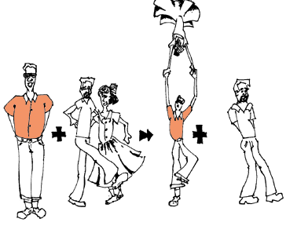
Let’s Review Single Replacement Reactions
Single element reactant must be higher up (more reactive) than the element in the compound.
Don’t forget to check the charges to get proper chemical formulas.
HONClBrIF’s!!!!!!!!!

Slide 3
Warm-up: Single Replacement Rxns: Will they go?
If the reaction occurs predict the products and balance the equation. If a reaction does not occur write no reaction.
AgNO₃ + Cu -------------------->
Cu + Al(NO₃)₃ -------------------->
Al + Cu(NO₃)₂ ------------------->
AgNO₃ _{(aq)} + Cu _{(s)} → CuNO₃ _{(aq)} + Ag _{(s)}
No Reaction
2 Al _{(s)} + 3 Cu(NO₃)₂ _{(aq)} → 2 Al(NO₃)₃ _{(aq)} + 3 Cu _{(s)}

Slide 4
General Types of Reactions (Continued)
5) _______________ Replacement: (sometimes called “Ionic”)
A reaction between _____ ________________ that are dissolved in water that produces _____ ________________ , one of which is ________________.
Water or a gas may be one of the two compounds being produced.
General Form: ____ + ____ → ____ + ____
You must use the Solubility Chart to see which product is the precipitate.
Table A-7 on p.887 ___ or _____= precipitate
Examples: CaCl_{2 (aq)} + AgNO_{3 (aq)} → _________ + ________
NaOH _{(aq)} + HCl _{(aq)} → ________ + ________
Double
two compounds
two compounds
insoluble
AX_{(aq)}
BY_{(aq)}
AY_{(aq)}
BX_{(s)}
+
+
I
sS
Ca(NO₃)₂
_{(aq)}
AgCl
_{(aq)}
NaCl
H₂O _{(l)}

Slide 5
How Does the Solubility Chart Work?
Look up the 2 parts of your compounds and then look for these symbols:
I—stands for insoluble which means makes a precipitate.
S—stands for soluble which means does not make a precipitate.
sS—stands for slightly soluble which means does not make a precipitate.

Slide 6
Will These Be Precipitates?
Use your solubility table to decide if these will be soluble (no precipitate) or insoluble (precipitate) in water:
NaNO₃
CaCO₃
BaSO₄
AgCl
NaOH

Slide 7
Double Replacement Rxns: Will they go?
If the reaction occurs predict the products and balance the equation. If a reaction does not occur write no reaction.
Na₂CO₃ + Ca(NO₃)₂ -------->
KCl + Na₂SO₄ -------->
Na₂CO₃ _{(aq)} + Ca(NO₃)₂ _{(aq)} → 2NaNO₃ _{(aq)} + CaCO_{3 (s)}
No Reaction
2KCl _{(aq)} + Na₂SO₄ _{(aq)} → 2NaCl _{(aq)} + K₂SO_{4 (aq)}

Slide 8
Double Replacement WS
Please make the word equations into formula equations.
Make sure you label the states of matter (in solution means aq).
Use your solubility rules to decide which PRODUCT is the precipitate.
If neither of the products make a precipitate, the reaction DOES NOT HAPPEN!!!!!!!

