Slide 1
Agenda
Gas Laws Quiz
Diffusion/Effusion
Intermolecular Forces Notes
Homework: Graham’s Law Practice, and Gas Laws Packet

Slide 2
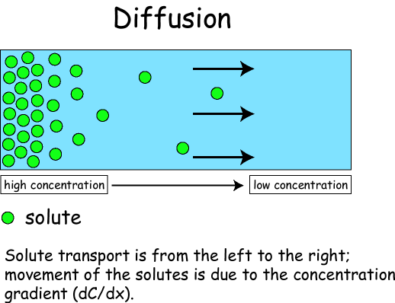
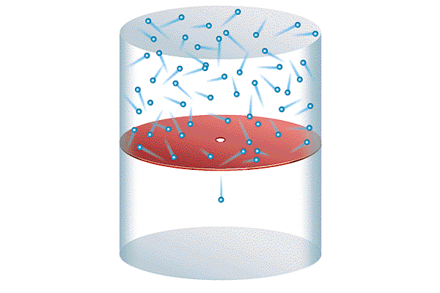
Diffusion vs. Effusion
The spreading out of a gas from _______ to _____ concentrations is called diffusion.
*Example: ___________ in a room spreads out
A gas escaping through a ______ _______ in a container is called effusion. As the size of a molecule _____________, the effusion speed and diffusion rate ______________...(inverse relationship.)
high
low
Perfume
tiny hole
increases
decrease
Effusion

Slide 3
Graham’s Law
Graham’s Law
Rate of diffusion of a gas is inversely related to the square root of its molar mass.
The equation shows the ratio of Gas A’s speed to Gas B’s speed.
Courtesy Christy Johannesson www.nisd.net/communicationsarts/pages/chem

Slide 4
Graham’s Law
35
36
Br
Kr
79.904
83.80
Determine the relative rate of diffusion for krypton and bromine.
The first gas is “Gas A” and the second gas is “Gas B”.
Relative rate mean find the ratio “v_{A}/v_{B}”.
Kr diffuses 1.381 times faster than Br₂.
Courtesy Christy Johannesson www.nisd.net/communicationsarts/pages/chem

Slide 5
Graham’s Law
1
8
H
O
1.00794
15.9994
A molecule of oxygen gas has an average speed of 12.3 m/s at a given temp and pressure. What is the average speed of hydrogen molecules at the same conditions?
Put the gas with the unknown speed as “Gas A”.
Courtesy Christy Johannesson www.nisd.net/communicationsarts/pages/chem

Slide 6
Graham’s Law
1
8
H
O
2.0
15.9994
An unknown gas diffuses 4.0 times faster than O₂. Find its molar mass.
The first gas is “Gas A” and the second gas is “Gas B”.
The ratio “v_{A}/v_{B}” is 4.0.
Square both sides to get rid of the square root sign.
Courtesy Christy Johannesson www.nisd.net/communicationsarts/pages/chem

Slide 7
IMF Foldable
You will fold your square piece of paper in half to make a triangle and then in half again to make a triangle
Unfold the paper and then fold the corners into the middle (it’ll look like the beginnings of a fortune teller)

Slide 8
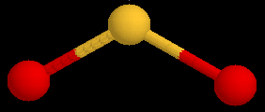
Definition of IMF
Attractive forces between molecules.
Much weaker than chemical bonds within molecules.
a.k.a. van der Waals forces

Slide 9
Types of IMF

Slide 10
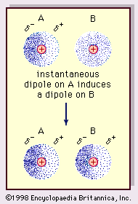
Types of IMF
London Dispersion Forces
Occur when electrons are uneven in a molecule causing non-polar to become polar for a moment
This causes the molecules to become attracted to each other for a moment
Example: like a light switch polarity switches on and off
Weakest Intermolecular force

Slide 11
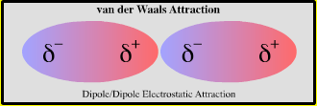
Types of IMF
Dipole-Dipole Force
Stronger than Dispersion forces
Occur between molecules that are permanently polar
Partial positive end of one molecule is attracted to partial negative end of another
Any molecule that has a dipole-dipole force will have London Dispersion

Slide 12
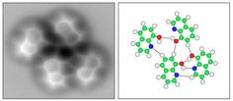
Types of IMF
Hydrogen Bonding
Strongest intermolecular force
Occur between molecules with hydrogen bonded to F, O, or N
Any compound that has hydrogen bonding will have the other two intermolecular forces

Slide 13
Determining IMF
NCl₃
CH₄
HF
NH₃

Slide 14
Determining IMF
NCl₃
polar = dispersion, dipole-dipole
CH₄
nonpolar = dispersion
HF
H-F bond = dispersion, dipole-dipole, hydrogen bonding
NH₃
H-N bond= dispersion, dipole-dipole, hydrogen bonding

Slide 15
POGIL
In pre-assigned groups of three you will finish your POGIL
Please assign the roles of manager, recorder, and reporter
REPORTERS: write the following paper on the bottom of the POGIL packet and be prepared to share your answer:

Slide 16
IMF Activity Demonstration
Need volunteers:
2 pairs for each type of intermolecular force.
3 students to be different strengths of energy
Polar pairs will hold arms out in front of them their hands is the positive pole and their shoulders are there negative poles
Non-polar pairs will hold arms at their sides

Slide 17
Homework
Graham’s Law WS
Finish Gas Laws Packet
Finish Partial Pressure WS
Finish Flic your Bic Lab

Slide 18
Day 7 Agenda
Warm-up: Intermolecular Forces
Notes Kinetic Molecular Theory and Phase Change Diagrams
Notes over altitude affects boiling point, vapor pressure

Slide 19
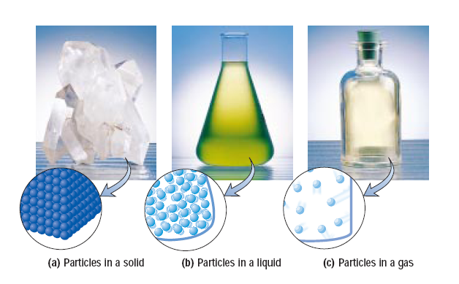
Ch. 13 & 14—Gases, Liquids & Solids
The Kinetic Theory
The kinetic theory is a way to describe the ___________ of particles.
It states that particles in all forms of matter, (S, L, G), are in constant motion, (either “__________”, “_________”, or “_________ _________”.)
motion
vibrating
sliding
flying
around

Slide 20
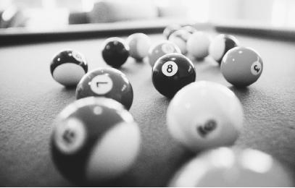
Assumptions of the Kinetic Theory
Here are 3 assumptions of the kinetic theory as it applies to gases:
(1) Gases are composed of _______ particles.
(2) These particles are in constant ___________ _______ motion and ______________ with other particles.
(3) When particles collide, kinetic energy, (K.E.), is _____________. K.E. is the energy of ___________. These types of collisions are called “_____________ elastic.”
If you could play pool using gas particles, they would never stop bouncing around the pool table!
tiny
straight line
collide
conserved
motion
perfectly
NOT perfectly elastic!!

Slide 21
Kinetic Molecular Theory
http://www.youtube.com/watch?v=nsgo0OqDBhk&feature=related

Slide 22
Kinetic Molecular Theory Part 2
Intro to Chemistry 6.1: Kinetic Molecular Theory (2/2) - YouTube

Slide 23
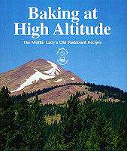
“Normal Boiling Point” of Water
At standard pressure (760 mm Hg), water’s normal B.P = ______˚C.
Once a liquid is boiling, adding heat _______ ________ increase its temperature. The liquid simply _________ more.
On a mountain, the atm. pressure is ___________, therefore the temperature at which the water boils is __________ than 100˚C.
100
DOES NOT
bubbles
lower
less
Foods in boiling water on a mountain will take __________ to cook since the boiling water is ____________ . (Some foods, like breads and cakes, have special cooking instructions for ___________ ______________.)
longer
cooler
high
altitudes

Slide 24
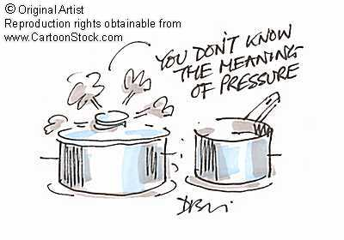
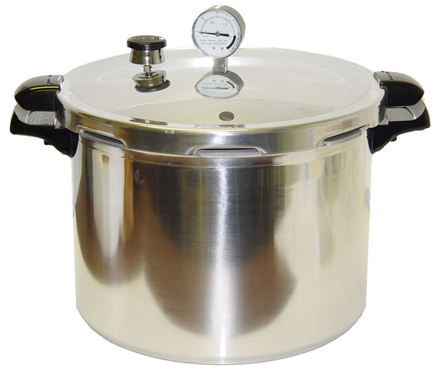
Boiling Water Above 100 ºC
In a pressure cooker, the atm. pressure is __________, therefore the temperature at which the water boils is ________ than 100˚C. Foods in a pressure cooker will cook ________ since the water is _________.
Water that’s next to volcanic vents on the ocean’s floor will reach temperatures well above 100˚ C, but it won’t “boil” since the surrounding pressure is so great!
higher
more
faster
hotter

Slide 25
Autoclave: Steam Sterilizer Using High Pressure

Slide 26
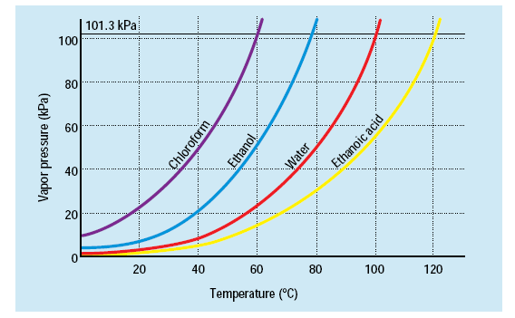
Boiling Points vs. Pressure
Practice Problems:
What is the normal boiling point for ethanoic acid? _______
At what temperature will ethanoic acid boil on Mt. Everest when the pressure is only 30 kPa? _______
120 ºC
80 ºC

Slide 27
Phase Diagrams Part 2
Intro to Chemistry 6.2: VP & Phase Diagrams (2/3) - YouTube

Slide 28
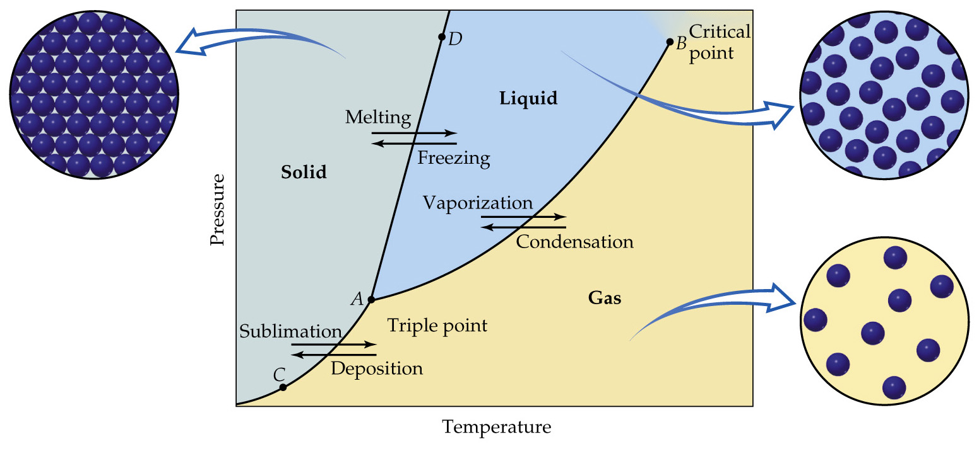
What is a Phase Diagram?
Shows the relationship between the 3 phases of matter at various temperatures and pressures.
Triple Point: All 3 phases of matter at ______________.
Critical Point: The highest temp. at which the liquid phase can exist.
equilibrium

Slide 29
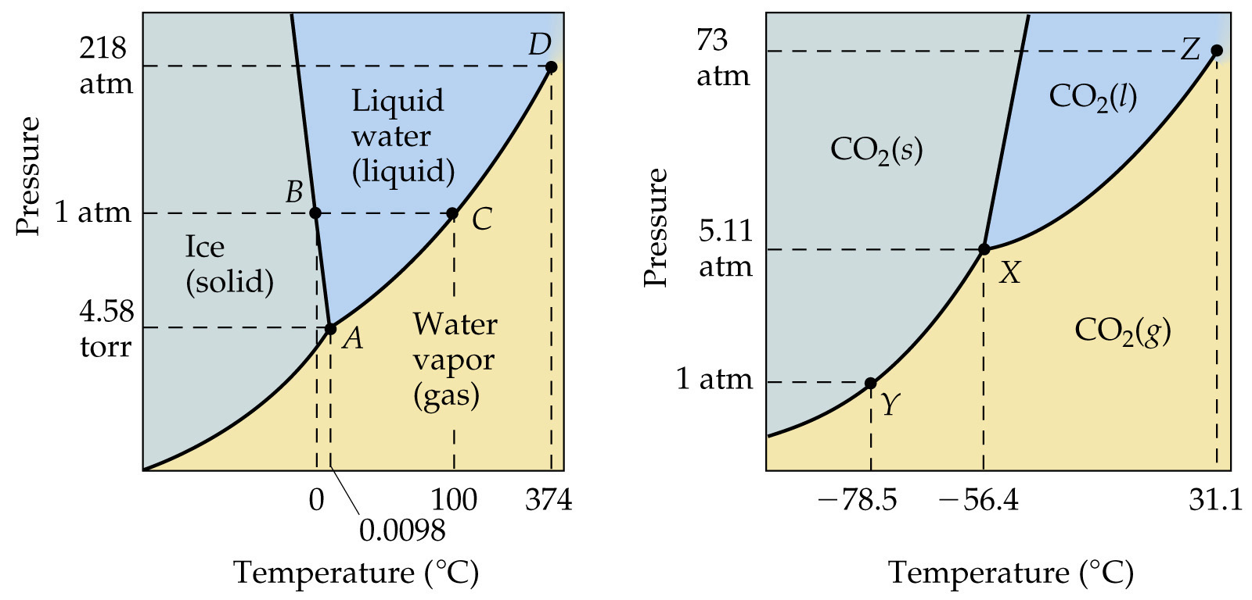
Phase Diagrams of H₂O and CO₂
For water, the triple point occurs at 0.01˚C and 4.58 mm Hg. This is a temperature close to water’s normal ____________ point, but a the pressure is very, very ________.
melting
low

Slide 30
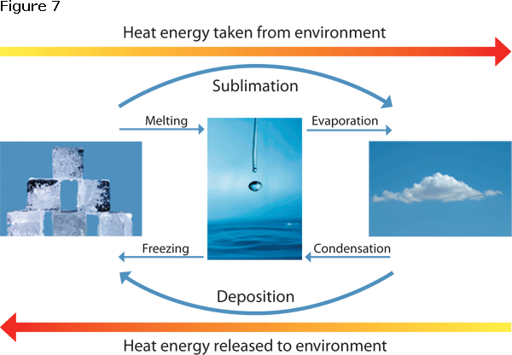
Names of the Phase Changes
Solid
Gas
Liquid
Solid→Aqueous = ___________ Aqueous → Solid = ___________
dissolving
crystallizing

Slide 31
The Moment You Have All Been Waiting For……DRY ICE BOMBS!!!
When we get into the lab you will need to wear goggles and aprons
In groups of 3 get a cup of water not filled to the brim but about 3/4 of the way full
Using the ends of the cut pipette scoop the crushed dry ice into the bulb of the pipette
Using pliers to clamp the top of the bulb shut hold the bulb in the cut of water
Watch for the triple point of the dry ice and HAVE FUN!!!!

Slide 32
Phase Diagrams Part 3
Intro to Chemistry 6.2: VP & Phase Diagrams 3/3 - YouTube

Slide 33
How Temperature Affects the Kinetic Energy of a Gas
The _________ the temperature the __________ the particles move, so the _________ K.E. the particles have! (________ Relationship: As Temperature increases, K.E. increases.)
At 0˚K, (______________ ______), kinetic energy is also ________.
Doubling the Kelvin temperature would ___________ the K.E. (Twice as hot means ________ the ___________ temperature.)
Proof that gas particle collisions conserve K.E. is that the room is not slowly getting colder!
higher
faster
more
Direct
Temp.
Kinetic Energy
absolute zero
zero
double
twice
Kelvin

Slide 34
Practice Problems:
What Celsius temperature is twice as hot as the freezing point of water, 0˚C?
What is three times hotter than −90˚C?
Which phase of water has the highest K.E.? ___ Lowest K.E? ___
Which has more average kinetic energy?
a) the air in a room
b) the floor in a room
c) Neither. They have the same average K.E.
Change to Kelvin…0 ºC +273 = 273 Kelvin
Now you can double the temp… 273 x 2 = 546 K
Now convert back to Celsius… 546− 273 = 273 ºC
Change to Kelvin… −90 ºC +273 = 183 Kelvin
Now you can triple the temp… 183 x 3 = 549 K
Now convert back to Celsius… 549 − 273 = 276 ºC
gas
ice

Slide 35
Intro to Gases Part 1
Intro to Chemistry 7.1: Intro to Gases - YouTube

Slide 36
Gas Pressure
When a gas particle collides with an object, it exerts a small __________. The result of simultaneous collisions from billions of gas particles upon an object causes gas pressure.
How to Measure Air Pressure
A barometer is the instrument used to measure air pressure.
There are 2 types of barometers:
(1) ____________ Barometer: a gauge measures how much a column of air in a container is squeezed together by the air pressure in the room.
The column of air is trapped in an “____________________-like” diaphragm. It can expand and contract.
A needle gauge ____________ to an air pressure scale on the container as it expands or contracts.
force
Aneroid
accordion
points

Slide 37
Aneroid Barometer

Slide 38
How to Measure Air Pressure (Continued)
(2) _____________ Barometer: measures the __________ of a column of mercury, (Hg), usually in units of _____ or ___________.
Here’s how to make a mercury barometer:
Step 1: Fill a 1 meter long “test tube” completely full of Hg.
Step 2: Fill a bowl with Hg.
Step 3: Without letting any Hg escape, put the tube of Hg upside-down in the bowl of Hg.
The ___________ of the column of Hg in the inverted tube will cause the level of Hg in the tube to initially ________.
Above the Hg there is a ___________, so not all of the Hg escapes.
The air pressure in the room is pushing __________ on the Hg in the bowl which pushes ______ on the column of Hg in the tube.
As the air pressure in the room increases and decreases, the height of the column of Hg in the tube goes _____ and ___________!
Mercury
height
mm
inches
weight
fall
vacuum
down
up
up
down

Slide 39
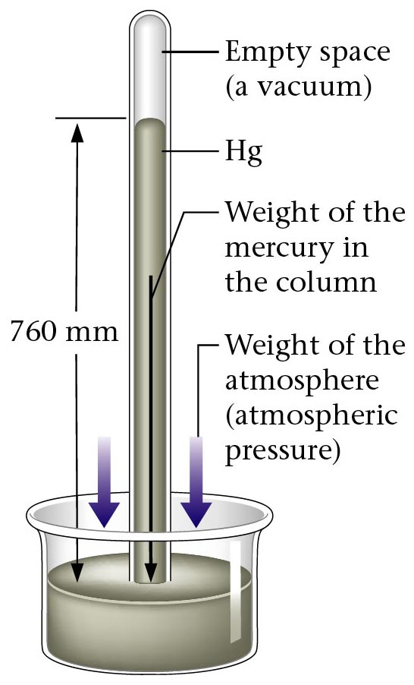
Mercury Barometer

Slide 40
How Altitude Affects Air Pressure
less
The higher up you go the ______ air molecules there are, so there are ______ collisions which will cause _____ pressure.
(______________ Relationship: As altitude inc., pressure dec.)
*Examples: This is the reason why your ears pop in ____________, ____________, or driving up and down large hills. (Going deep under the water will also cause your ears to pop because of increasing __________ pressure.)
fewer
less
Inverse
Altitude
(See Mercury Barometer image on previous page!)
Air Pressure
elevators
planes
water

Slide 41
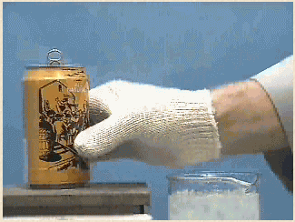
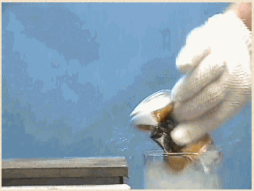
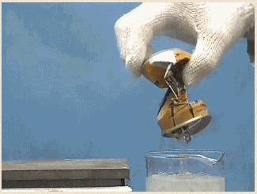
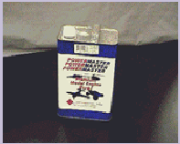
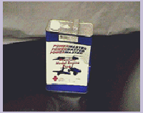
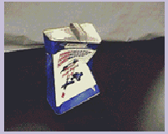
Air Pressure Crushing Cans
http://www.csun.edu/scied/4-discrpeant-event/the_can_crush/index.htm

Slide 42
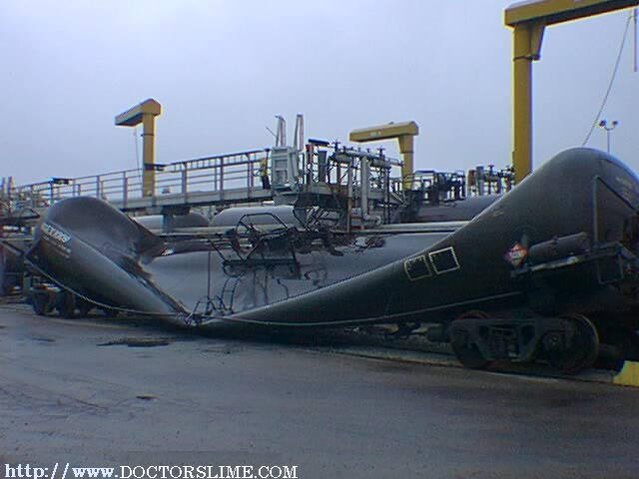
Air Pressure Crushing “Cans”

Slide 43
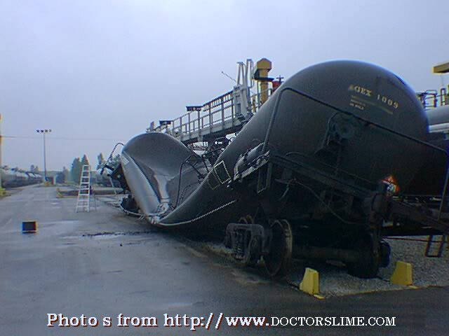
Air Pressure Crushing “Cans”

Slide 44
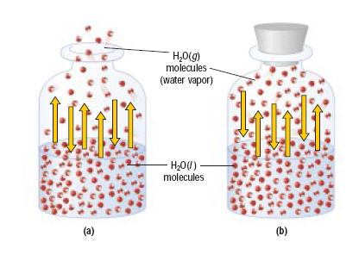
Dynamic Equilibrium
A dynamic equilibrium can be defined as a _______________ of an __________ # of particles back and forth from one state of matter to another.
To be in equilibrium, the _______ of one phase change must ______ the ______ of another phase change.
movement
equal
rate
equal
rate
(a)– Open Container NOT at equilibrium
(b) Closed Container that is at equilibrium between the liquid and vapor phases. The rate of _______________ equals the rate of __________________.
evaporation
condensation

Slide 45
How Temperature Affects the Vapor Pressure
Vapor Pressure is simply the push of a gas above its liquid.
As the temperature of a liquid increases, so does the ____________ of vapor particles.
More vapor particles cause more ____________, therefore _______ vapor pressure. [___________ Relationship: (T ↑ Vapor Pressure ↑)]
number
collisions
more
Direct
Low Temperature
High Temperature

Slide 46
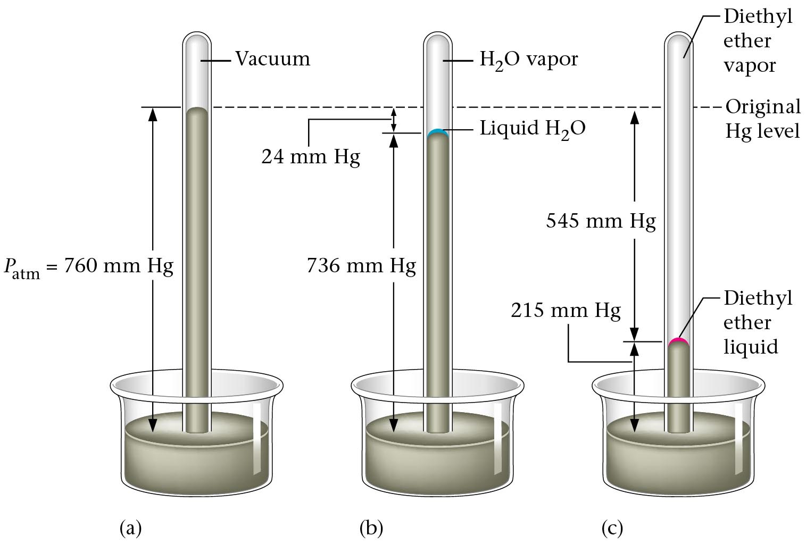
Figure 14.5-- (a) Measuring vapor of a liquid by using a simple barometer. (b) The water vapor pushed the mercury level down. (c) Diethyl ether shows a higher vapor pressure than water.

Slide 47
Why Liquids Boil
Any liquid will boil when the atmospheric (air) pressure __________ the __________ pressure of the liquid.
Inside of the bubble there is _________ _________ pressure pushing outward which keeps the shape of the bubble.
equals
vapor
water vapor
vapor
This image shows the inner- right-side of a bubble.
liquid

Slide 48
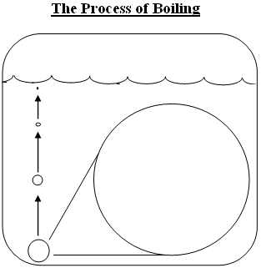
Why Liquids Boil (Continued)
Before the water gets hot enough, the bubble will get squished by the external ______________ ____________ pushing in as it moves up through the water, and it won’t quite make it to the surface.
When the internal water vapor pressure __________ the external air pressure, the bubble can keep its shape to the top, and water boils.
atmospheric pressure
equals
Key: = interior water vapor pressure
= exterior atmospheric pressure

Slide 49
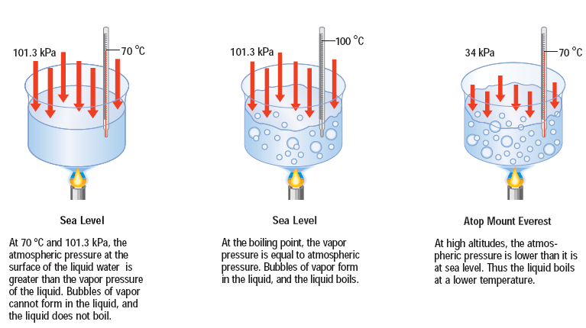
3 Ways to Make Water Boil: How to Get the Pressures Equal
(1) _________________: Raising the temperature of the water will increase the vapor pressure until it equals the atmospheric pressure.
(2) __________________: Lower the external pressure above the liquid by _____________ ______ the air until the atmospheric pressure is equal to the vapor pressure of the water.
(3) __________________: Lower the air pressure and heat it.
Heat it up!
Use a vacuum pump
pulling out
“Combo”

Slide 50
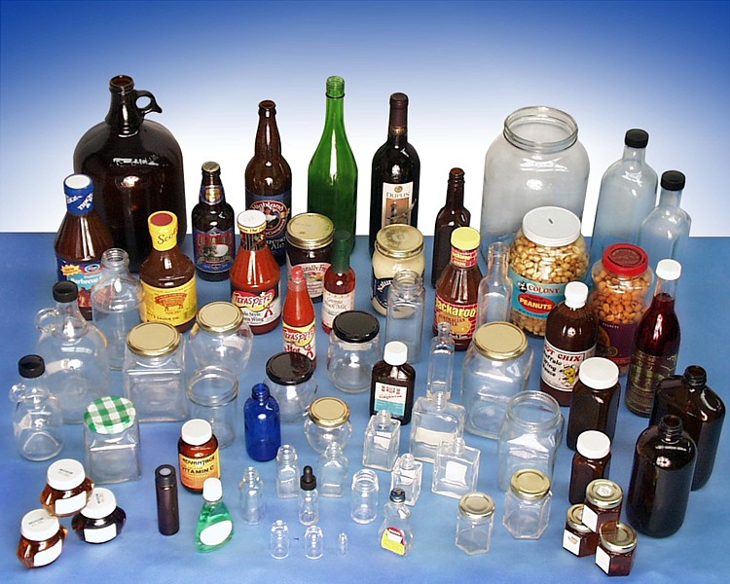
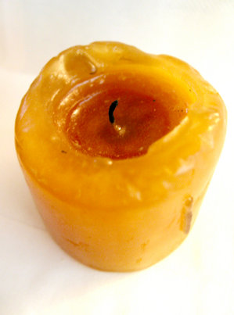
The Nature of Solids
There are 2 general classifications of solids:
______________ : No ___________ to the arrangement of particles. Their melting point is over a _______ __________ of temperatures. They just get ________ and ________ when heated.
Examples:________, syrup, _____, butter, gum, Jell-O, _______.
Amorphous
pattern
wide range
softer
softer
wax
glass
plastic

Slide 51
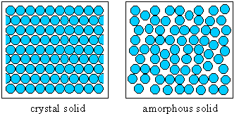
The Nature of Solids (continued)
(2) ______________: Well-ordered, ____________ arrangement of atoms. Crystals have a ___________ structure and a melting point at a very narrow range of temperatures.
Examples: ________, ________, quartz, ________, ________, __________, __________
Crystalline
definite
repeating
sugar
salt
diamonds
rubies
water (ice)
gold

Slide 52
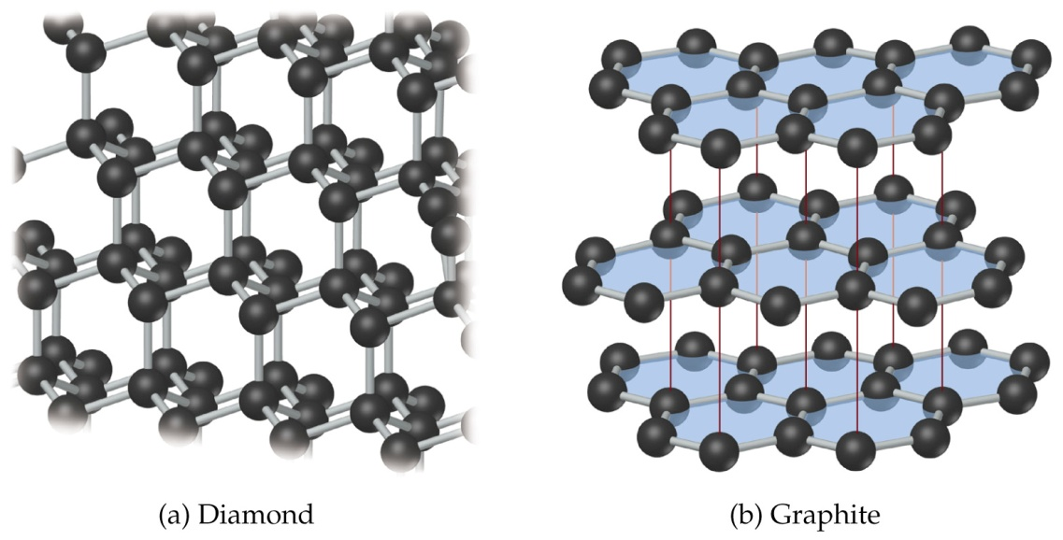
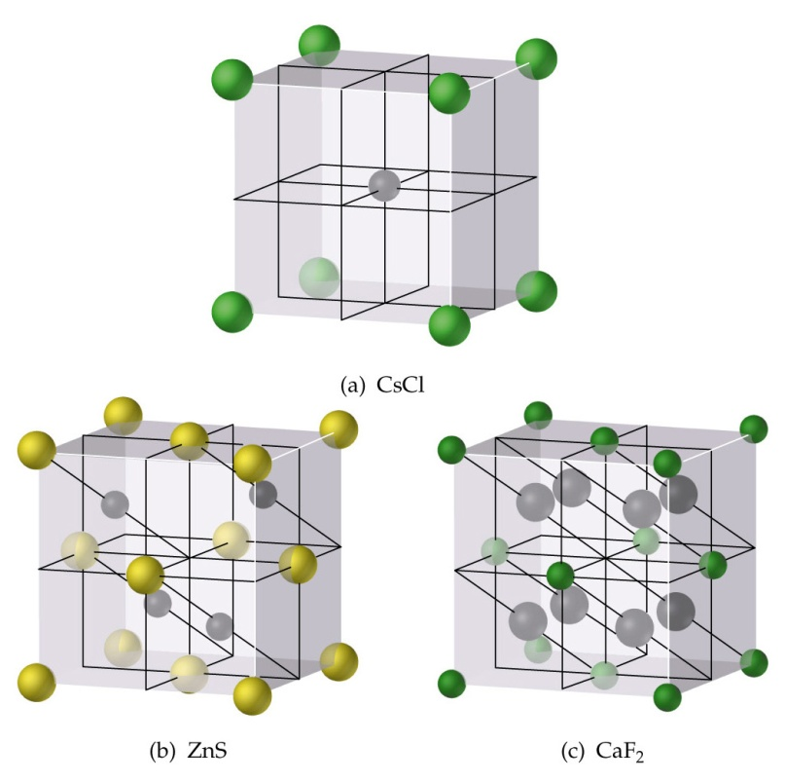
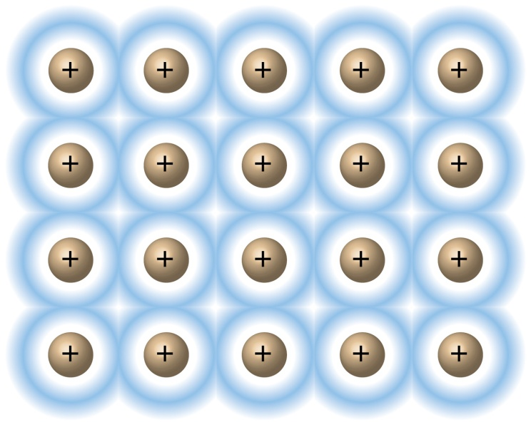
Crystalline Solids
Water molecules
Covalent Network
Ionic (Salts)
Metallic

Slide 53
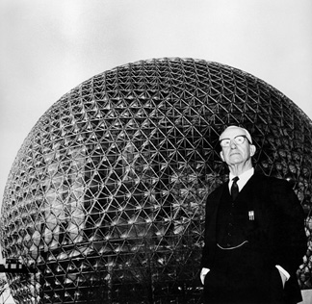
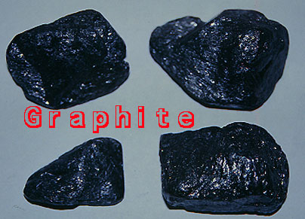
Allotropes
Some substances have more than one crystalline arrangement to their atoms. The different crystalline patterns are called allotropes.
*Example: Carbon has 3 allotropes:
(1) ________________= “flat layers” of atoms
(2) ________________= ”cubic blocks” of interlocking atoms
(3) “________________”= a “soccer ball-shaped sphere” of 60 atoms
Graphite
Diamond
Buckyball
buckminsterfullerene

