Slide 1
Agenda
Quiz: Diffusion/Effusion, IMF, and Kinetic Molecular Theory
Notes Solutions
Practice: Molarity and Dilutions

Slide 2
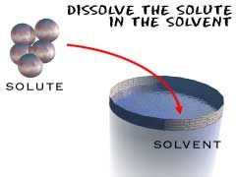
Aqueous Solutions
There are two parts to a solution:
1) ____________- the dissolving medium which is typically a liquid or the substance in greater amount when 2 similar phases are mixed
2) _____________ - the substance that dissolves
Solvent
Solute

Slide 3
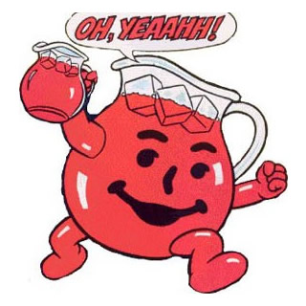
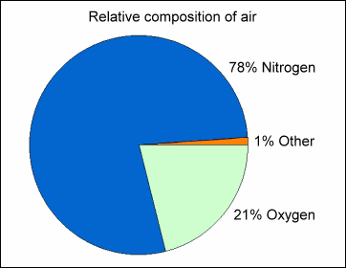
Examples of common solutions:
Kool-aid = _________ in _______
Air = ____ in ____
sugar
water
O₂
N₂
14K gold = _______ in _________
silver
gold

Slide 4
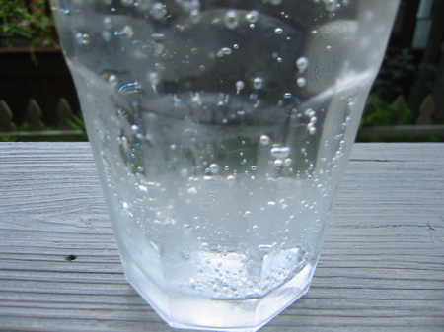
Examples of common solutions:
__________ = copper in zinc
Cola Drinks = sugar in water and ______ in ___________
Brass
CO₂
water

Slide 5
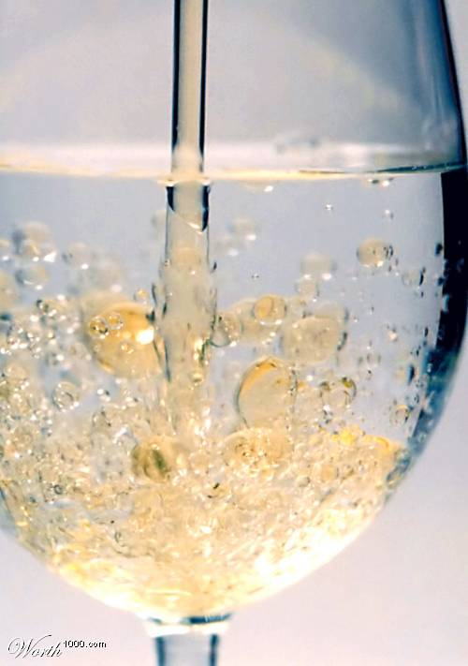
“Like Dissolves Like”
polar
This phrase means that polar solvents dissolve __________ solutes and nonpolar solvents dissolve ___________ solutes.
Example: Mix together water, oil, table salt, and iodine (I₂).
What dissolves in what? ________________
____________________________________
____________________________________
____________________________________
nonpolar
The nonpolar oil will dissolve the nonpolar I₂
and the water dissolves the salt since they are
both polar.

Slide 6
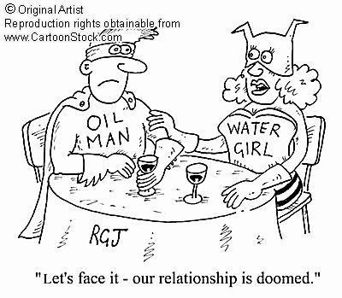
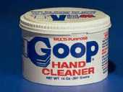
“Like Dissolves Like”
nonpolar grease remover

Slide 7
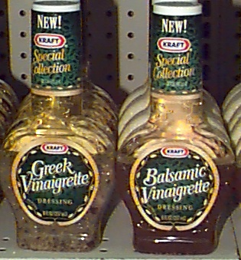
“Unlike Polarity Cannot Dissolve Unlike”
Vinegar & oil dressing will separate. Shake well before using!

Slide 8
Solutions & Electricity
__________________- a solution that conducts electricity.
__________________- a solution that does not conduct electricity.
What Determines if a Solution will Conduct Electricity?
A solution will conduct if there are ____________ ______________ (or _________), in the solution.
Will a Solution be a Strong or Weak Electrolyte?
Using the Solubility Chart:
______ = many ions in the solution = __________________
______= few ions in the solution = ____________________
______= no ions in the solution = _____________________
Electrolyte
Nonelectrolyte
charged particles
ions
S
Strong Electrolyte
sS
Weak Electrolyte
I
Nonelectrolyte
The Solubility Chart only lists ionic substances so if it isn’t in the chart it isn’t ionic and it isn’t an electrolyte!

Slide 9
The Light Bulb Demonstration
bright glow weak glow no glow
Strong Electrolyte Weak Electrolyte Nonelectrolyte
completely dissociate into ions
Examples: salt water, _______, drain cleaner
incompletely dissociate into ions
Examples: tap water, __________
no dissociation
Examples: sugar in water, _____, alcohol
oil
HCl
vinegar

Slide 10
Types of Mixtures
Type of Mixture Suspension Colloid True Solution
Relative Particle Size
Do the particles sink to
the bottom over time?
Can you filter out the particles?
Do the particles scatter a beam of light?
Examples
Large
Medium
Small
YES
NO
NO
YES
NO
NO
YES
YES
NO
muddy water
jello, paint, milk
air, brass, sugar water, salt water
Tyndall Effect

Slide 11
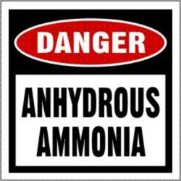
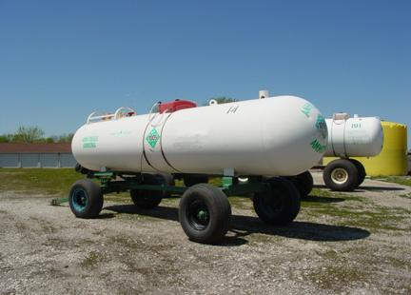
Water Vocabulary
hydrate- crystals that contain __________. (See Fig. 17.15 & Table 17.4)
Example: CuSO₄·5H₂O copper (II) sulfate pentahydrate
anhydrous- no _________ at all in the _______________.
Examples: ___________ ______________, CaCl₂ beads.
water
water
crystal
Anhydrous ammonia

Slide 12
Ch. 18-- Solutions
Solubility tells us how much _________ can dissolve in a certain amount of _____________ at a particular temperature and pressure to make a “__________________” solution.
Solution Vocabulary
_________________ solutions: the solution cannot hold any more solute. (Some solute may be sitting on the bottom of the container.)
________________ solutions: the solution could dissolve more solute
____________________ solutions: the solution is holding more than it should at the given temperature, and if you messed with the solution by shaking it or throwing in one more crystal, the whole thing would _________________ rapidly!
solute
solvent
saturated
Saturated
Unsaturated
Supersaturated
crystallize

Slide 13
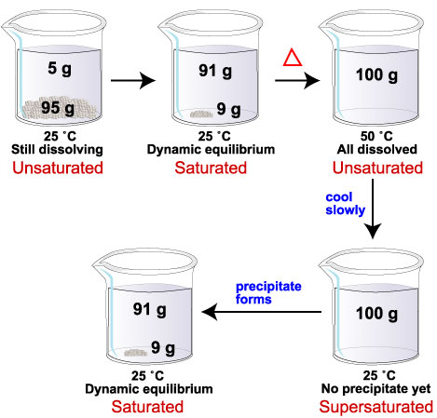

Slide 14
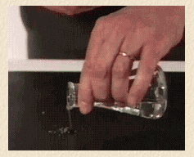
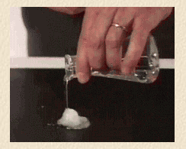
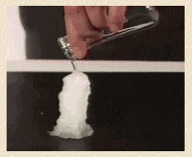
Supersaturated Sodium Acetate Solution

Slide 15
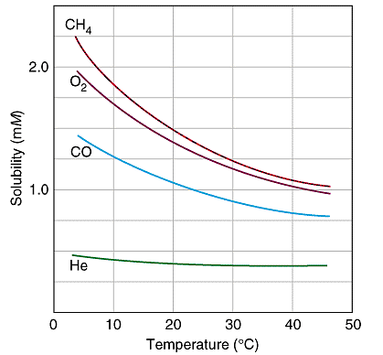
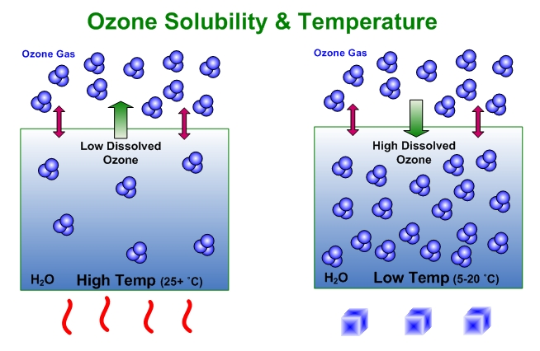
Factors that Affect Solubility
1) Temperature:
a) Gas dissolved in Liquid: As temperature_____ , solubility ______.
Examples: O₂ in a fish tank…(________ water suffocates fish.)
CO₂ in soda… (_________ soda loses fizz.)
inc.
dec.
Warm
Warm

Slide 16
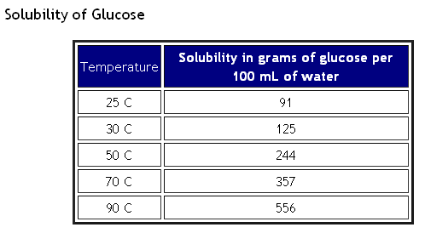
Factors that Affect Solubility: Temperature
b) Solid dissolved in Liquid: As temperature ______ , solubility “generally” ________________.
Example: sugar in hot tea vs. sugar in iced tea
inc.
increases

Slide 17
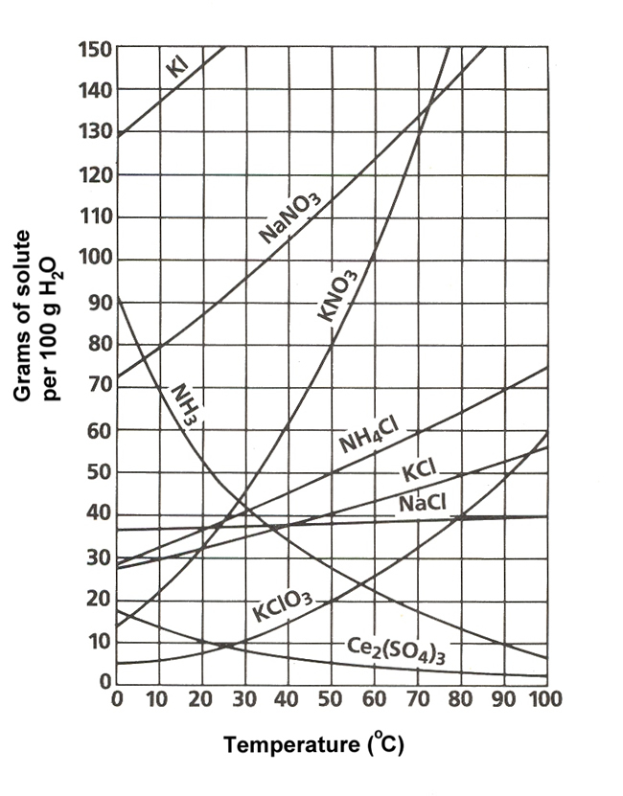
Factors that Affect Solubility: Temperature
(abnormal behavior)

Slide 18
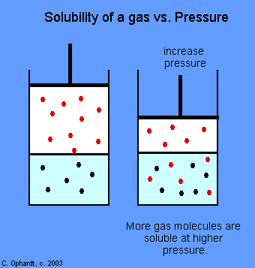
Factors that Affect Solubility
2) Pressure:
a) Gas dissolved in Liquid: As pressure _____ , solubility ______.
Examples: CO₂ in soda: (made under _______ pressure)
inc.
inc.
high

Slide 19
Factors that Affect Solubility: Pressure
b) Solid dissolved in Liquid: As pressure ___________ , solubility ______ ______ _____________!!
Since you cannot compress either a solid or a liquid, pressure has ____ effect on the solubility!
- - - - - - - - - - - - - - - - - - - - - - - - - - - - - - - - - - - - - - - - - - - - - - - - -
inc.
does not change
no

Slide 20
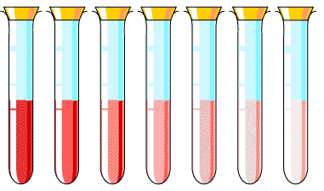
Measuring the Concentration of a Solution
___________________: how much solute is dissolved in a certain amount of solvent at some given temperature and pressure.
Qualitative Vocabulary
_______________ : contains a small amount of solute
_______________ : contains a large amount of solute
Concentration
Dilute
Concentrated
concentrated
dilute

Slide 21
Dilutions
Equation to calculate a dilution is:
M₁V₁=M₂V₂
Example: Concentrated sulfuric acid (H2SO4) has a concentration of 18 M. What volume of the concentrated H₂SO₄ is needed to make 2.5 liters of a 1.0 M solution?
M₁V₁=M₂V₂
M₁= 18 M V₁= ? M₂= 1.0 M V₂= 2.5 L
18x = (1.0)(2.5)
X = 0.139 L or 139 mL

Slide 22
Quantitative Vocabulary:
____________: moles of solute per liter of solution
_______________ ( ) = moles of solute ÷ Liters of solution
Practice Problem: What is the molar concentration of an aqueous NaCl solution when 25.0 grams are dissolved in water to make 500 mL of solution?
Molarity
Molarity
M
moles
Grams of solute = (M) x (L) x (Molar Mass)
X
Molarity
Liters
25.0 g = (M) x (0.500 L) x (58.5 g/mole)
Molarity = 0.855 M

Slide 23
