Slide 1
Agenda
Dual Credit Packets
Collect Word Equations WS
Notes Reaction types
Demos Next Time
HW: Single Replacement WS (Balancing too ☺)

Slide 2
Dual Credit Packet
Packets are DUE February 26th
Payment is DUE May 13th
You may rip off the front and back page
You will need to fill out the front page that says Dual Credit Registration Form
Subject: Chem
Course # 101/101L
Section: 004D
Credits: 4

Slide 3
Dual Credit Packet (Con’t)
You will need a cosigner on the back if you are under 18 (This is a parent/guardian)
Records Release and Consent Form
I would check the box for Academic Records
You do not need to fill out anything for the Certificate of Residency
Sophomores ONLY will need to fill out the last page

Slide 4
State Money
You will need to go back on and delegate where you want your money to go if you haven’t used it all up already
You are responsible for paying for the course

Slide 5
By the end of the day you should be able to…
Recognize, set-up and predict products for the following types of reactions:
Synthesis reactions
Decomposition reactions
Combustions reactions
Single-replacement reaction
Determine if a single replacement reaction will occur using an activity series of metals chart.

Slide 6
Five General Types of Reactions
Decomposition
1) ________________________:
A reaction that breaks apart ______ ______________ into simpler substances, (usually two elements or an element and a smaller compound.)
General Form: _____ → ___ + ___
Examples: H₂O → _____ + _____
KClO₃ → _____ + _____
Remember that “HONClBrIF” elements are diatomic when alone!!
one compound
+
AX
A X
H₂
O₂
KCl
O₂

Slide 7
Categories of Decomposition (and Composition ) Reactions
CaO
CO₂
a) carbonates → metallic oxide + CO₂ CaCO₃ → _____ + _____
b) chlorates → metallic chloride + O₂ NaClO₃ → _____ + _____
c) hydroxides → metallic oxide + H₂O Mg(OH)₂ → _____ + _____
d) oxy acids → nonmetal oxide + H₂O H₂SO₄ → _____ + _____
e) binary compounds → 2 elements NaCl → _____ + _____
Every time you try to write the formula for a new compound, you must look up the ___________ of the ions and ___________ them if they are different!!
Balance it _________ you get all the correct formulas written first!
Don’t forget about the HONClBrIF’s!
NaCl
O₂
MgO
H₂O
SO₃
H₂O
Na
Cl₂
charges
cross
AFTER

Slide 8
General Types of Reactions (Continued)
2) _______________: (sometimes called “Combination” or “Composition”)
A reaction of _____ __________________, typically a metal and a nonmetal to form ______ ______________.
It is the opposite of decomposition. (The same categories of reactions from above apply, just in reverse.)
General Form: ___ + ___ → _____
Examples: Al + Cl₂ → _______
PbO + H₂O → ______
Synthesis
two substances
one compound
+
A
X
AX
AlCl₃
2 elements →
binary compound
Pb(OH)₂
metallic + water
oxide
→ hydroxide

Slide 9
General Types of Reactions (Continued)
3) _________________:
A reaction between a Carbon/Hydrogen (and sometimes Oxygen) _________________ with _____.
The products are always the same… ________ + ________
This reaction is too easy!! Don’t miss it!
General Form: C_{x}H_{y} + O₂ → ____ + ____
Examples: C₂H₂ + O₂ → _______ + _______
C₇H₆O + O₂ → _______ + _______
Combustion
compound
O₂
CO₂
H₂O
CO₂
H₂O
CO₂
H₂O
CO₂
H₂O

Slide 10
General Types of Reactions (Continued)
4) _____________ Replacement:
A reaction between ____ ______________ and ___ ____________ that produces a different _____________ and ______________.
General Forms: ____ + __ → ____ + __
____ + __ → ____ + __
The element that is trying to replace the other must be ________ _______________ than the one it is replacing.
You must use the Activity Series to see if the reaction will happen.
Table 8.2 _________ ___ = more reactive
Elements from ____ to ____ can displace hydrogen in water to form a metallic hydroxide and H₂ gas.
Single
one compound
one element
compound
element
+
AX
Y
AY
X
AX
B
BX
A
+
more
reactive
Higher up
Li
Na

Slide 11
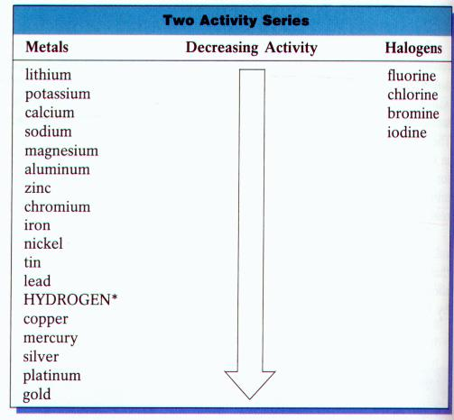
Activity Series

Slide 12
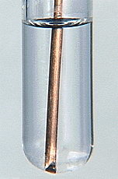
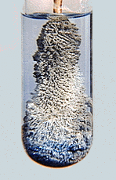
Single Replacement Reactions
Examples:
NaCl + F₂ → _____ + _____
FeCl₂ + K → _____ + _____
HCl + Zn → _____ + _____
HCl + Au → _____ + _____
H₂O + Na → _____ + _____
H₂O + Fe → _____ + _____
AgNO₃ + Cu → _____ + _____
NaF
Cl₂
KCl
Fe
ZnCl₂
H₂
no reaction
NaOH
H₂
H(OH)
no reaction
CuNO₃
Ag

