Slide 1
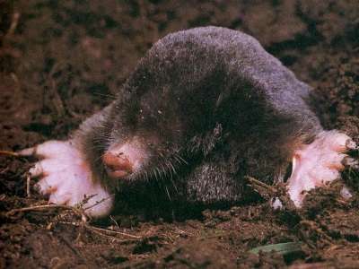
The Mole
Avogadro’s Number = 6.022 x 10²³
Notes:
Objectives:
To state the value of Avogadro’s number: 6.02 x10²³.
To state the mass of Avogadro’s number of atoms for any element by referring to the periodic table.
To relate the moles of a substance to the number of particles.
http://www.birdxcanada.com/sonic/mole_400.jpg

Slide 2

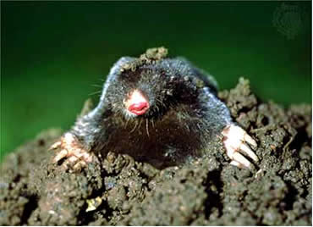
Counting Atoms
Chemistry is a quantitative science - we need a "counting unit."
The MOLE
1 mole is the amount of substance that contains as many particles (atoms or molecules) as there are in 12.0 g of C-12.
Notes:
http://web.syr.edu/~nstefanc/New%20Counting.JPG
http://www.wildcru.org/research/farming/moles/mole1.jpg

Slide 3
The Mole is Developed
AvogadroPaper
Carbon Atoms | Hydrogen Atoms | Mass Ratio
Number Mass (amu) | Number Mass (amu) | Mass carbon / Mass hydrogen
12 | 1 | 12 amu = 12 1 amu 1
24 [2 x 12] | 2 [2 x 1] | 24 amu = 12 2 amu 1
120 [10 x 12] | 10 [10 x 1] | 120 amu = 12 10 amu 1
600 [50 x 12] | 50 [50 x 1] | 600 amu = 12 50 amu 1
(6.02 x 10²³) x (12) | Avogadro’s number (6.02 x 10²³) x (1) | (6.02 x 10²³) x (12) = 12 (6.02 x 10²³) x (1) 1
Avogadro’s
number
Notes:
http://dbhs.wvusd.k12.ca.us/webdocs/ChemTeamIndex2.html (link for Avogadro paper)

Slide 4
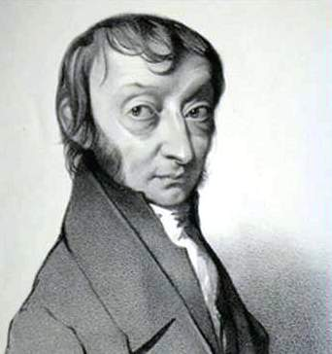
Amadeo
Avogadro
(1776 – 1856)
Particles in a Mole
Amedeo Avogadro (1766-1856)
never knew his own number;
it was named in his honor by a
French scientist in 1909.
its value was first estimated
by Josef Loschmidt, an Austrian
chemistry teacher, in 1895.
?
quadrillions
thousands
trillions
billions
millions
1 mole = 602213673600000000000000
or 6.022 x 10²³
There is Avogadro's number of particles in a mole of any substance.
Notes:
A more precise value of Avagadro’s number = 6.022045 E23.
How could you determine the number of sugar crystals in a bowl of sugar?
Is it possible to get a reasonably close estimate?

Slide 5
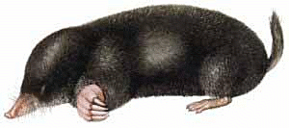
Careers in Chemistry - Philosopher
Q: How much is a mole?
A: A mole is a quantity used by chemists to count atoms and
molecules. A mole of something is equal to 6.02 x 10²³ “somethings.”
1 mole = 602 200 000 000 000 000 000 000
Q: Can you give me an example to put that number in perspective?
A: A computer that can count 10,000,000 atoms per second would
take 2,000,000,000 years to count 1 mole of a substance.
Notes:
The Cray-1 supercomputer prototype was built by Cray Research, Inc. The Cray-1 contained 200,000 integrated circuits and could perform 100 million floating point operations per second (100 MFLOPS). Using this machine it would still take 200 million years to count to 1 mole!

Slide 6
Counting to 1 Mole
Is that right? A computer counting 10 million atoms every second
would need to count for 2 billion years to count just a single mole.
Lets look at the mathematics.
365 days
24 hours
60 min
60 sec
x sec = 1 year
= 31,536,000 sec
1 year
1 day
1 hour
1 min
Therefore 1 year has 31,536,000 seconds or 3.1536 x 10⁷ sec.
A computer counting 10,000,000 atoms every second could count
3.153 x 10¹⁴ atoms every year.
Finally, 6.02 x 10²³ atoms divided by 3.1536 x 10¹⁴ atoms every year
equals 1,908,929,477 years or approximately 2 billion years!

Slide 7
How Big is a Mole?
https://www.youtube.com/watch?v=TEl4jeETVmg

Slide 8
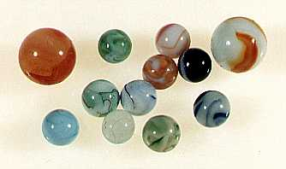

How Big is a Mole?
One mole of marbles would cover the entire Earth
(oceans included) for a depth of three miles.
One mole of $100 bills stacked one on top of another
would reach from the Sun to Pluto and back 7.5 million
times.
It would take light 9500 years to travel from the
bottom to the top of a stack of 1 mole of $1 bills.
Notes:
6.02 x 10²³ softballs = volume of Earth
6.02 x 10²³ Olympic shot puts = mass of Earth
6.02 x 10²³ atoms H laid side by side would encircle Earth ~1,000,000 times

Slide 9
Avogadro’s Number
A MOLE of any substance contains as many elementary units (atoms and molecules) as the number of atoms in 12 g of the isotope of carbon-12.
This number is called AVOGADRO’s number N_{A} = 6.02 x 10²³ particles/mol
The mass of one mole of a substance is called MOLAR MASS symbolized by MM
Units of MM are g/mol
Examples
  H₂ hydrogen 2.02 g/mol
  He helium 4.0 g/mol
  N₂ nitrogen 28.0 g/mol
  O₂ oxygen 32.0 g/mol
  CO₂ carbon dioxide 44.0 g/mol

Slide 10
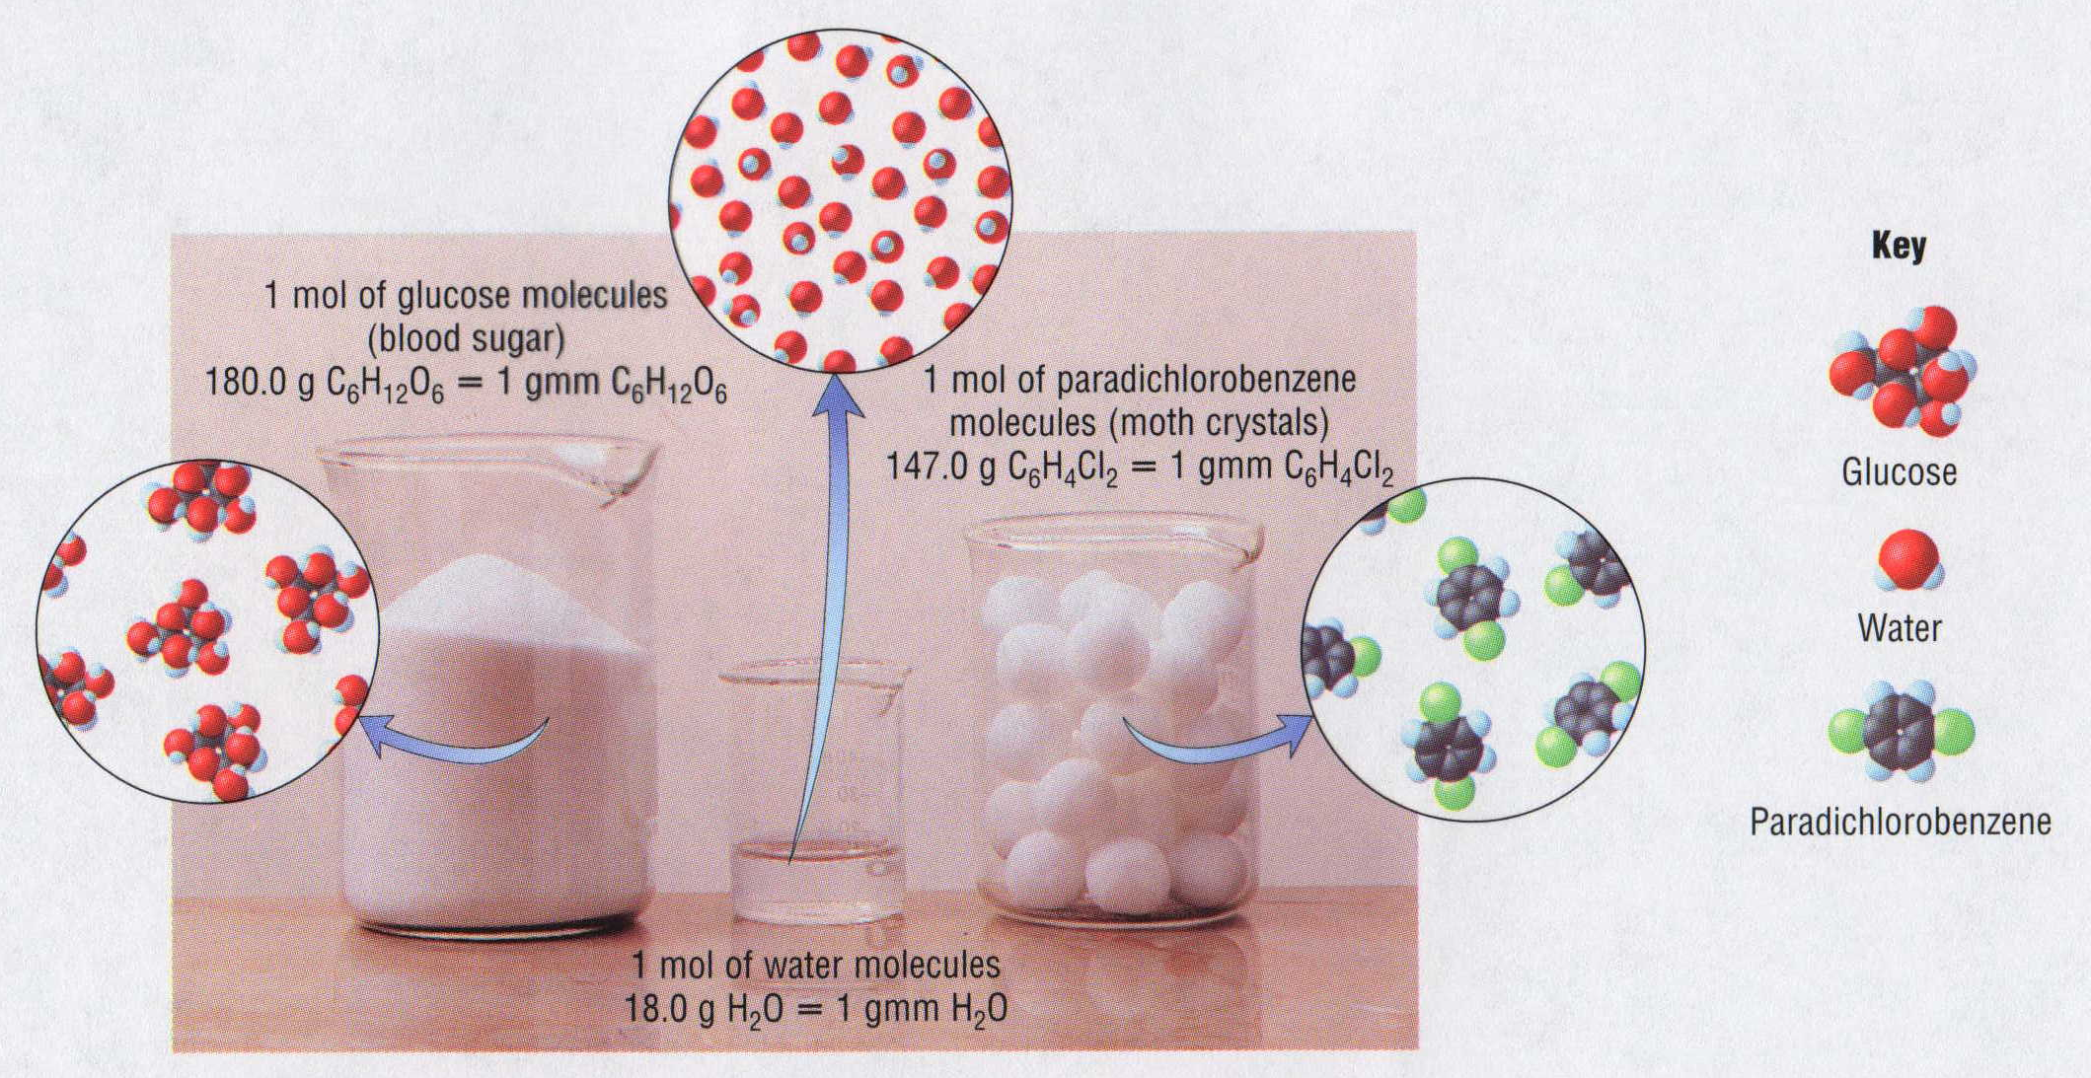
1 Mole of Particles

Slide 11
m
Chemistry
v
MOL
p
Unit 6:
The Mathematics of
Chemical Formulas
SO₃
Na₂CO₃ . 10 H₂O
Cu(OH)₂

Slide 12
# of H₂O molecules | # of H atoms | # of O atoms
1
2
3
100
6.02 x 10²³
2
1
4
2
6
3
200
100
2 (6.02 x 10²³)
6.02 x 10²³
18.0 g
2.0 g
16.0 g
molar mass:
the mass of one mole of a substance

Slide 13
PbO₂
Pb:
1
(207.2 g)
= 207.2 g
239.3 g
O:
2
(16.0 g)
= 32.0 g
HNO₃
H:
1
(1.0 g)
= 1.0 g
N:
1
(14.0 g)
= 14.0 g
63.0 g
O:
3
(16.0 g)
= 48.0 g
ammonium phosphate
NH₄¹⁺
PO₄^{3–}
(NH₄)₃PO₄
N:
3
(14.0 g)
= 42.0 g
H:
12
(1.0 g)
= 12.0 g
149.0 g
P:
1
(31.0 g)
= 31.0 g
O:
4
(16.0 g)
= 64.0 g

Slide 14
percentage composition: the mass % of each
element in a compound
g element
% of element =
x 100
molar mass of compound
Find % composition.
(see calcs above)
PbO₂
207.2 g Pb
:
239.2 g
= 86.6% Pb
32.0 g O
:
239.2 g
= 13.4% O
(NH₄)₃PO₄
42.0 g N
:
149.0 g
= 28.2% N
12.0 g H
:
149.0 g
= 8.1% H
31.2 g P
:
149.0 g
= 20.8% P
64.0 g O
:
149.0 g
= 43.0% O

Slide 15

zinc acetate
Zn²⁺
CH₃COO^{1–}
Zn(CH₃COO)₂
Zn:
1
(65.4 g)
= 65.4 g
= 35.7% Zn
C:
4
(12.0 g)
= 48.0 g
= 26.2% C
:
183.4 g
H:
6
(1.0 g)
= 6.0 g
= 3.3% H
O:
4
(16.0 g)
= 64.0 g
= 34.9% O
183.4 g

Slide 16
Empirical Formula Steps
Percent to grams (assume you have 100 g of your sample so your present is now a equal to grams)
Grams to mole (divide by mass of the element)
Divide by smallest (divide by smallest mole)
Multiply until whole. (if you don’t have a whole number multiply to make a whole number.)

Slide 17
Finding an Empirical Formula from Experimental Data
1. Find # of g of each element.
“What’s your flavor
of ice cream?”
2. Convert each g to mol.
3. Divide each “# of mol” by the smallest “# of mol.”
4. Use ratio to find formula.
A compound is 45.5% yttrium and 54.5% chlorine.
Find its empirical formula.
YCl₃

Slide 18
A ruthenium/sulfur compound is 67.7% Ru.
Find its empirical formula.
RuS_{1.5}
Ru₂S₃

Slide 19
A 17.40 g sample of a technetium/oxygen compound
contains 11.07 g of Tc. Find the empirical formula.
TcO_{3.5}
Tc₂O₇

Slide 20
A compound contains 4.63 g lead, 1.25 g nitrogen,
and 2.87 g oxygen. Name the compound.
?
PbN₄O₈
?
lead (IV) nitrite
Pb(NO₂)₄
(plumbic nitrite)
Pb? 4 NO₂^{1–}

Slide 21
To find molecular formula…
(“What’s your
flavor?”)
A. Find empirical formula.
B. Find molar mass of
empirical formula.
C. Find n = mm molecular
mm empirical
D. Multiply all parts of
empirical formula by n.
(“How many scoops?”)
(How many empiricals “fit into” the molecular?)

Slide 22
A carbon/hydrogen compound is 7.7% H and has a
molar mass of 78 g. Find its molecular formula.
emp. form. → CH
78 g
mm_{emp} =
13 g
= 6
C₆H₆
13 g

Slide 23
A compound has 26.33 g nitrogen, 60.20 g oxygen,
and molar mass 92 g. Find molecular formula.
NO₂
92 g
mm_{emp} =
46 g
= 2
N₂O₄
46 g

Slide 24
Mole Calculations
Mass
(g)
1 mol = molar mass (in g)
Volume
(L or dm³)
1 mol = 22.4 L
MOLE
(mol)
1 mol = 22.4 dm³
Particle
(at. or m’c)
1 mol = 6.02 x 10²³ particles

Slide 25
Mass
(g)
1 mol = molar mass (in g)
Volume
(L or dm³)
1 mol = 22.4 L
MOLE
(mol)
1 mol = 22.4 dm³
New Points about
Island Diagram:
Particle
(at. or m’c)
1 mol = 6.02 x 10²³ particles
a. Diagram now has four islands.
b. “Mass Island” now for elements or compounds
c. “Particle Island” now for atoms or molecules
d. “Volume Island”: for gases only
1 mol @ STP = 22.4 L = 22.4 dm³

Slide 26
ferrous nitrate
ferrous nitrate
What mass is 1.29 mol ?
Fe²⁺
NO₃^{1–}
Fe(NO₃)₂
(
)
179.8 g
1.29 mol
= 232 g
1 mol
How many molecules is 415 L at STP?
sulfur dioxide
sulfur dioxide
SO₂
(
)
(
)
1 mol
6.02 x 10²³ m’c
415 L
22.4 L
1 mol
= 1.12 x 10²⁵ m’c

Slide 27
aluminum sulfate
aluminum sulfate
What mass is 6.29 x 10²⁴ m’cules ?
Al³⁺
SO₄^{2–}
Al₂(SO₄)₃
(
)
(
)
1 mol
342.3 g
6.29 x 10²⁴ m’c
6.02 x 10²³ m’c
1 mol
= 3580 g
At STP, how many g is 87.3 dm³ of nitrogen gas?
N₂
(
)
(
)
1 mol
28.0 g
87.3 L
= 109 g
22.4 L
1 mol

Slide 28
How many m’cules is 315 g of iron (III) hydroxide?
Fe³⁺
OH^{1–}
Fe(OH)₃
(
)
(
)
315 g
1 mol
6.02 x 10²³ m’c
106.8 g
1 mol
= 1.78 x 10²⁴ m’c
How many atoms are in 145 L of CH₃CH₂OH at STP?
(
)
(
)
1 mol
6.02 x 10²³ m’c
145 L
22.4 L
1 mol
= 3.90 x 10²⁴ m’c
But there are 9 atoms per molecule, so…
9 (3.90 x 10²⁴)
= 3.51 x 10²⁵ atoms

Slide 29
Hydrates and Anhydrous Salts
anhydrous salt: an ionic compound (i.e., a salt) that
attracts water molecules and forms
loose chemical bonds with them;
symbolized by MN
“anhydrous” = “without water”
Uses:
“desiccants” in leather
goods, electronics, vitamins
hydrate: an anhydrous salt with the water attached
-- symbolized by MN . ? H₂O
Examples:
CuSO₄ . 5 H₂O BaCl₂ . 2 H₂O
Na₂CO₃ . 10 H₂O FeCl₃ . 6 H₂O

Slide 30




H₂O
H₂O
H₂O
HEAT
H₂O
H₂O
MN
H₂O
MN
+
H₂O
H₂O
H₂O
H₂O
H₂O
H₂O
hydrate
anhydrous salt
water
ENERGY
+
ENERGY
+

Slide 31
Finding the Formula
of a Hydrate
1. Find the # of g of MN and # of g of H₂O.
2. Convert g to mol.
3. Divide each “# of mol” by the smallest “# of mol.”
4. Use the ratio to find the hydrate’s formula.

Slide 32

Find formula of hydrate for each problem.
sample’s mass before
heating = 4.38 g
MN . ? H₂O
(hydrate)
sample’s mass after
heating = 1.93 g
MN
(anhydrous salt)
molar mass of anhydrous salt = 85 g
MN . 6 H₂O

Slide 33
A. beaker = 46.82 g
B. beaker + sample before
heating = 54.35 g
beaker +
salt + water
C. beaker + sample after
heating = 50.39 g
beaker + salt
molar mass of anhydrous salt = 129.9 g
MN . 8 H₂O

Slide 34
A. beaker = 47.28 g
B. beaker + sample before
heating = 53.84 g
beaker +
salt + water
C. beaker + sample after
heating = 51.48 g
beaker + salt
molar mass of anhydrous salt = 128 g
MN . 4 H₂O

Slide 35
For previous problem, find % water and
% anhydrous salt (by mass).
or…

Slide 36
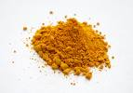
Review Problems
Find % comp. of
iron (III) chloride.
iron (III) chloride.
Fe³⁺
Cl^{1–}
FeCl₃
Fe:
1
(55.8 g)
= 55.8 g
→ 34.4% Fe
:
162.3 g
Cl:
3
(35.5 g)
= 106.5 g
→ 65.6% Cl
162.3 g

Slide 37
A compound contains 70.35 g C and 14.65 g H.
Its molar mass is 58 g. Find its molecular formula.
emp. form. → C₂H₅
58 g
mm_{emp} =
29 g
= 2
C₄H₁₀
29 g

Slide 38
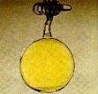

At STP, how many g is
548 L of chlorine gas?
Cl₂
(
)
(
)
1 mol
71.0 g
548 L
= 1740 g
22.4 L
1 mol

Slide 39
Strontium chloride
is an anhydrous salt on which the
following data were collected. Find formula of hydrate.
Strontium chloride
A. beaker = 65.2 g
B. beaker + sample before
heating = 187.9 g
beaker +
salt + water
C. beaker + sample after
heating = 138.2 g
beaker + salt
Sr²⁺
Cl^{1–}
SrCl₂
SrCl₂ . 6 H₂O

